Slide 1
Chapter 13

Slide 2
Objectives

Slide 3
Objectives (continued)

Slide 4
Properties of the Number object

Slide 5
Examples of properties of the Number object

Slide 6
Methods of the Number object

Slide 7
Examples of methods of the Number object

Slide 8
One property of the Math object

Slide 9
Common methods of the Math object

Slide 10
Examples of common methods of the Math object

Slide 11
Examples of common methods of the Math object (continued)

Slide 12
The exponentiation operator of ECMAScript 2015+

Slide 13
The random() method of the Math object

Slide 14
Examples of the Math.random method

Slide 15
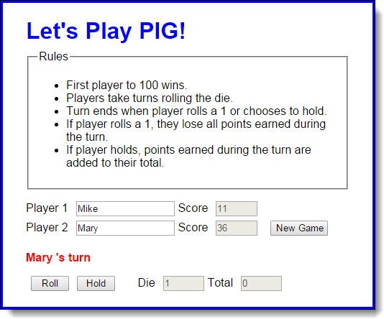
The user interface for the PIG application

Slide 16
The HTML for the PIG application

Slide 17
The HTML for the PIG application (continued)

Slide 18
The JavaScript for the PIG application

Slide 19
The JavaScript (continued)

Slide 20
The JavaScript (continued)

Slide 21
One property of String objects

Slide 22
Methods of String objects

Slide 23
Examples of methods of String objects

Slide 24
Examples of methods of String objects (continued)

Slide 25
Example 1: How to trim spaces off the beginning of a string

Slide 26
Example 2: How to trim spaces off the end of a string

Slide 27
Example 3: How to combine ltrim and rtrim to trim all spaces

Slide 28
Example 4: How to compare two strings ignoring case

Slide 29
Example 5: A function for comparing two strings while ignoring case

Slide 30
How to create a Date object that represents the current date and time

Slide 31
How to create a Date object by specifying date parts

Slide 32
How to create a Date object by copying another Date object

Slide 33
Some unexpected results when specifying a date string

Slide 34
How the constructor for the Date object works

Slide 35
The formatting methods of a Date object

Slide 36
The get methods of a Date object

Slide 37
The set methods of a Date object

Slide 38
Example 1: How to display the date in your own format

Slide 39
Example 2: How to calculate the days until the New Year

Slide 40
Example 3: How to calculate a due date

Slide 41
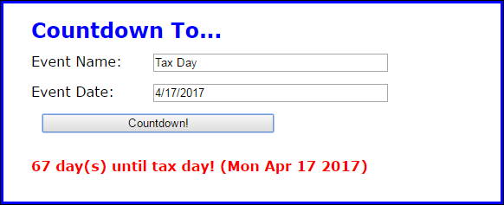
The user interface of the Count Down application

Slide 42
The HTML for the application

Slide 43
The CSS rule set for the <p> element

Slide 44
The JavaScript for the Countdown application

Slide 45
The JavaScript (continued)

Slide 46
The JavaScript (continued)

Slide 47
Exercise 13-1 Enhance the Future Value app

Slide 48
Extra 13-1 Develop the Change Calculator

Slide 49
Extra 13-2 Develop the Calendar application

Slide 50
Short 13-1 Improve the Countdown validation

